Slide 1
Review Radar AI: Customer Insight Discovery Engine
Domain: Business Analytics
Presented BY:
Burugupalli Sai Ritisha - AP23110010443
Sreenidhi Bala subramanyam - AP23110010422
Suram Sai Charan Reddy - AP23110010432
Kotaru Sravya - AP23110010581
Yaganti Siva Himani - AP23110010418

Slide 2

Problem Statement
The Challenge
Businesses struggle to analyze customer sentiment at scale due to the lack of intelligent tools for processing unstructured data.
Large Volume
Keyword Limitations
Unstructured review data overwhelming traditional systems
Misses context and fails with synonyms
Manual Filtering
No Insights
Time-consuming and inefficient process
Lack of actionable business intelligence
Example: "Battery drains fast" vs "Poor battery backup" → same meaning but different words

Slide 3
Objectives & Goals
This system bridges the gap between raw data and business intelligence through AI-powered semantic understanding.
Semantic Search System
Natural Language Queries
Insight Extraction
Develop intelligent search that understands meaning beyond keywords
Enable users to search using conversational language
Extract meaningful patterns from customer reviews
Decision Efficiency
Reduce Effort
Improve business decision-making speed and accuracy
Minimize human intervention in data analysis

Slide 4




Proposed Solution
Key Concepts
The system understands intent, not just words, making it more intelligent than traditional keyword-based systems.
Context-aware retrieval
Meaning-based matching
Semantic understanding
NLP Pipeline
Processes and understands text meaning
Embedding Generation
Converts text into numerical vectors
Vector Storage
Saves embeddings in optimized database
Similarity Matching
Finds contextually relevant results

Slide 5
Technology Stack
Python
NLP Libraries
Sentence-BERT
Core development language providing flexibility and extensive libraries for AI and NLP tasks
NLTK and Transformers for advanced natural language processing and understanding
Pre-trained embedding models that capture semantic meaning effectively
Vector Database
FastAPI
FAISS or Chroma for efficient similarity search and storage of high-dimensional vectors
Modern backend framework for building APIs that connect frontend and backend seamlessly

Slide 6
System Architecture
This layered architecture ensures modularity, scalability, and maintainability throughout the system.
Data Ingestion Layer
Accepts CSV input files containing customer reviews and raw data
Processing Layer
Applies NLP techniques and generates semantic embeddings
Storage Layer
Persists vector representations in optimized database
API Layer
FastAPI handles request routing and response generation
User Interface Layer
Provides intuitive interface for querying and visualization

Slide 7
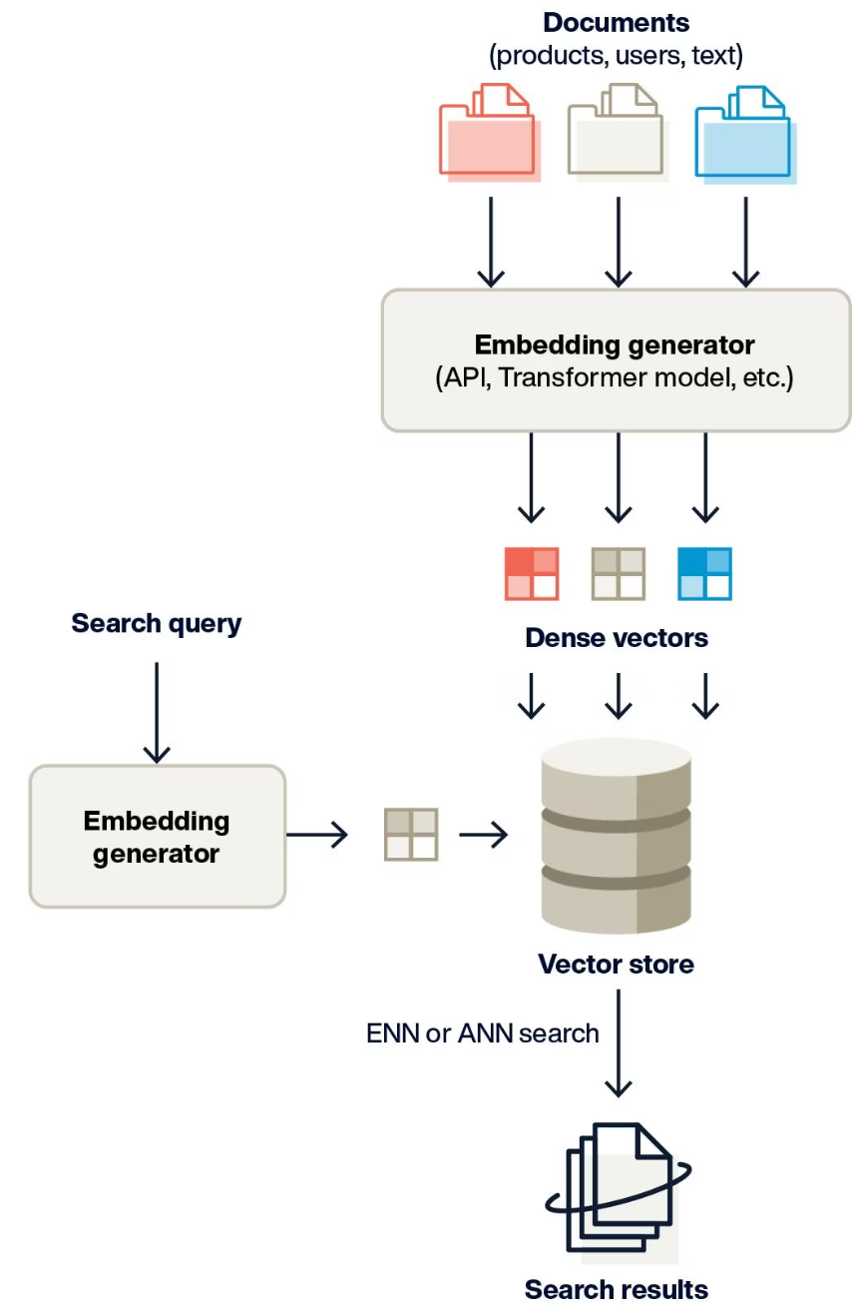

Workflow & Methodology
Load Dataset
Read and clean CSV data
Preprocess Text
Tokenization and stopword removal
Generate Embeddings
Create vector representations
Store Vectors
Save to vector database
Accept Query
Get user search input
Search Similarity
Find matching reviews
Return Results
Display relevant insights
Example: Query "Delivery issues" retrieves multiple related complaints about shipping problems

Slide 8
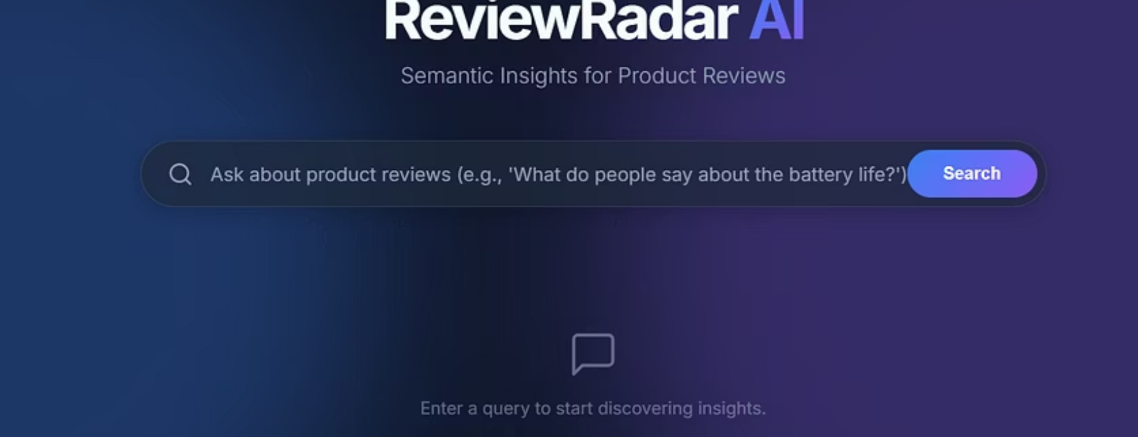
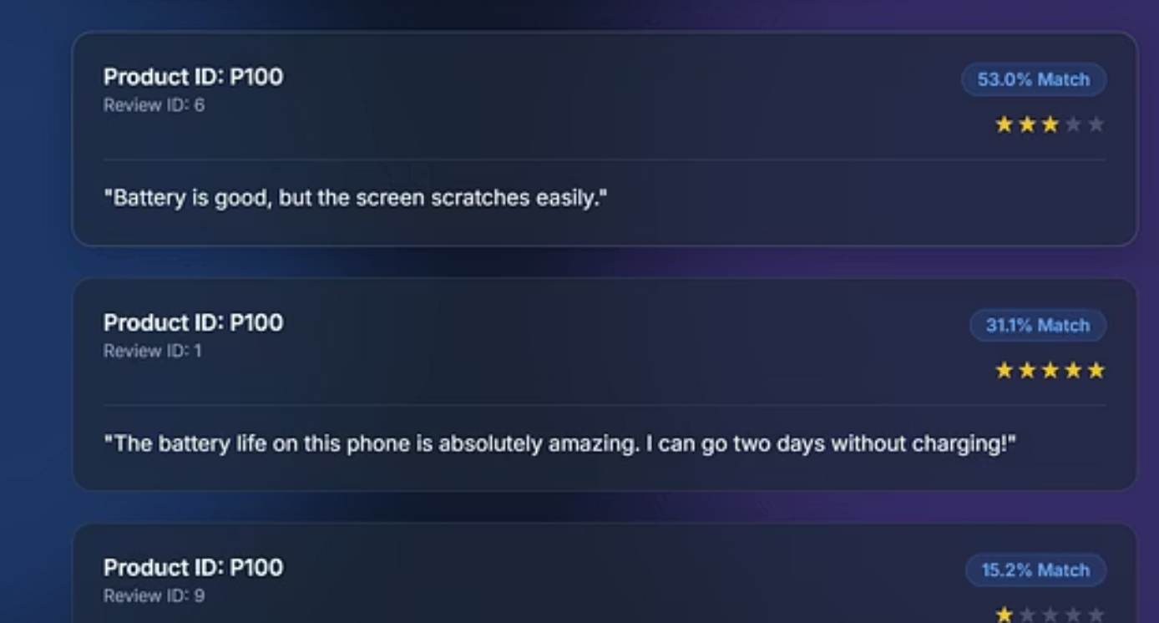
OUTPUT AND RESULTS

Slide 9
Features, Advantages & Limitations
✅ Features
✅ Advantages
⚠️ Limitations
Semantic Search
Saves Time
Model Quality
Understands meaning and context
Automates manual analysis
Requires good embedding models
Fast Retrieval
Better Accuracy
Computational Cost
Real-time results from large datasets
Context-aware matching
Resource-intensive processing
Scalable Architecture
Large Datasets
Setup Complexity
Handles growing data volumes
Processes thousands of reviews
Initial configuration effort
Every system has trade-offs, but the benefits significantly outweigh the limitations for most business use cases.

Slide 10
Applications & Conclusion
Applications
E-commerce Analysis
Customer Feedback
Review analysis for online retail platforms
Systematic processing of customer input
Product Insights
Social Analytics
Identify improvement opportunities
Monitor brand sentiment across platforms
Conclusion
AI-Driven Extraction
Improved Decision-Making
Reduced Manual Effort
Transforms unstructured text into structured insights
Provides actionable business intelligence
Automates time-consuming analysis tasks
This project demonstrates how AI can transform unstructured data into actionable insights for businesses.

Slide 11
THANK YOU!

